Slide 1
Big data and visualization

Slide 2
Abstract and learning objectives
Abstract
Deploy a web app using Machine Learning to predict travel delays given flight delay data and weather conditions. Plan a bulk data import operation, followed by preparation, such as cleaning and manipulating the data for testing, and training your Machine Learning model.
Learning objectives
Build a complete Azure Machine Learning (ML) model
Integrate an Azure ML web service into a Web App
Use Azure Data Factory (ADF) for data movement and operationalizing ML scoring
Summarize data with HDInsight and Spark SQL
Visualize batch predictions on a map using Power BI
Notes:
This is an introduction to the Cloud Workshop at a high level. Later we’ll get into customer objections, requirements, etc… but we want to ground the participants on the business outcomes we’re going after for the day.

Slide 3
Step 1: Review the customer case study
Outcome
Analyze your customer needs
Timeframe
15 minutes

Slide 4

Customer situation
AdventureWorks Travel (AWT) provides concierge services for business travelers.
Interested in using predictive analytics to differentiate themselves in an increasingly crowded market.
Notes:
AdventureWorks Travel provides concierge services for business travelers
Working In an increasingly crowded market
Always looking for ways to differentiate themselves, and provide added value to their corporate customers.
Looking to capitalize on their existing data assets to provide new insights that provide them a strategic advantage against their competition
Interested in using predictive analytics to help customers best select their travels.

Slide 5




Customer situation
Proposed solution to provide flight delay risk assessment to customers
Plan to use 30 years of flight delay and weather data
Want to pilot the solution internally
Notes:
Most premium customers often book their travel within 7 days of departure, and often ask questions like, “I don’t have to be there until Tuesday, so is it better for me to fly out on Sunday or Monday?”
AWT believes an innovative solution is to provide customers an assessment of the risk of encountering flight delays, based on historical trends in weather patterns.
Flight delay predictions would be presented to customers through a web-based map visualization.
AWT has over 30 years of historical flight data provided to them by the United States Department of Transportation (USDOT), and the historical weather condition for each flight as CSV files. They plan to use this data to predict the likelihood of flight delays to help customers plan their trips.
REST API calls to a 3rd party service will be used to retrieve current weather forecasts.
AWT plans to pilot this solution internally, whereby the small population of customer support who service AWT’s premium tier of business travelers would begin using the solution and offering it as an additional data point for travel optimization.

Slide 6

Customer needs
Modernize their analytics platform
Ability to query data using SQL
Load and store all data in Azure
Use current weather forecast for flight delay predictions
Proof of concept machine learning model
Web-based visualizations of flight delay predictions
Notes:
AWT wants to modernize their analytics platform, without sacrificing their ability to query data using SQL.
They are looking for an approach that allows them to store all of their data in Azure, including the unmodified source data and the cleansed data from which they query for production purposes.
AWT want to understand how they will load their large quantity of historical data into Azure. The data is currently stored on-premises.
They need the ability to query the current weather forecast, and use it as input to their flight delay predictions.
They desire a proof of concept machine learning model that takes as input their historical data on flight delays and weather conditions in order to identify whether a flight is likely to be delayed or not.
Need web-based visualizations of the flight delay predictions.

Slide 7































The Azure Data Landscape
AZURE
DATA FACTORY
AZURE IMPORT EXPORT SERVICE
AZURE SQL DB
AZURE COSMOS DB
AZURE SQL DATA WAREHOUSE
AZURE
ANALYSIS SERVICES
POWER BI
AZURE CLI
AZURE SDK
AZURE HDINSIGHT
(HADOOP / SPARK)
AZURE DATA LAKE
ANALYTICS
AZURE
HDINSIGHT
AZURE
DATABRICKS
AZURE DATA LAKE
ANALYTICS
AZURE
DATABRICKS
ML SERVER
AZURE ML
ML SERVER
AZURE STORAGE
BLOBS
AZURE DATA LAKE
STORE
AZURE ML
AZURE IOT HUB
AZURE EVENT HUBS
AZURE
STREAM ANALYTICS
AZURE
HDINSIGHT
AZURE
DATABRICKS
AZURE SEARCH
AZURE
DATA CATALOG
AZURE
STREAM ANALYTICS
STORM AND SPARK STREAMING ON AZURE HDINSIGHT
BOT SERVICE
COGNITIVE SERVICES
KAFKA ON
AZURE HDINSIGHT
AZURE EXPRESSROUTE
AZURE
ACTIVE DIRECTORY
AZURE NETWORK
SECURITY GROUPS
AZURE KEY
MANAGEMENT SERVICE
OPERATIONS
MANAGEMENT SUITE
AZURE FUNCTIONS
VISUAL STUDIO

Slide 8
The Azure BIG Data Landscape
AZURE
DATA FACTORY
AZURE IMPORT EXPORT SERVICE
AZURE SQL DB
AZURE COSMOS DB
AZURE SQL DATA WAREHOUSE
AZURE
ANALYSIS SERVICES
POWER BI
AZURE CLI
AZURE SDK
AZURE STORAGE
BLOBS
AZURE DATA LAKE
STORE
AZURE DATA LAKE
ANALYTICS
AZURE
HDINSIGHT
AZURE
DATABRICKS
AZURE ML
ML SERVER
AZURE
DATABRICKS
AZURE IOT HUB
AZURE EVENT HUBS
AZURE SEARCH
AZURE
DATA CATALOG
AZURE
STREAM ANALYTICS
AZURE
HDINSIGHT
AZURE
DATABRICKS
BOT SERVICE
COGNITIVE SERVICES
KAFKA ON
AZURE HDINSIGHT
AZURE EXPRESSROUTE
AZURE
ACTIVE DIRECTORY
AZURE NETWORK
SECURITY GROUPS
AZURE KEY
MANAGEMENT SERVICE
OPERATIONS
MANAGEMENT SUITE
AZURE FUNCTIONS
VISUAL STUDIO

Slide 9

Customer objections
Does Azure Machine Learning require a PhD in statistics?
How long does it take to create and operationalize a machine learning model?
Can operationalized ML models be flexible in the inputs they support?
Notes:
Does Azure offer a machine learning solution that does not require a PhD in statistics?
We have heard that creating a machine learning model takes a month to build and another 2–3 months to operationalize so that it is useable from our production systems. Is this true?
We’d like our operationalized models to be flexible in the inputs they support. In some cases, we want to provide both the flight and weather data to get a prediction. In others we just want to provide flight data and have the weather looked up. Is this possible?

Slide 10

Customer objections
What are the options for running SQL on Hadoop solutions in Azure?
Does Azure offer anything to speed up querying files in HDFS?
How can we identify, monitor, and protect PII data?
Notes:
Are there any additional services in the Azure Marketplace we could use to identify data loaded that contains PII, monitor access to sensitive data and protect the data at rest (via encryption or masking)?
Is HDInsight our only option for running SQL on Hadoop solutions in Azure?
Can we query flat files in the file system using SQL?
Does Azure provide anything that would speed up querying (and exploration) of files in HDFS?

Slide 11



Customer objections
Is Azure Data Lake a good fit for our PoC?
Can access to our SQL DW be limited using Azure Active Directory?
What data visualization tools are available on Azure? Can access to these be managed with Active Directory?
Notes:
We have heard of Azure Data Lake, but we are not clear about whether this is currently a good fit for our PoC solution, or whether we should be using it for interactive analysis of our data.
We would like to limit access to our SQL DW using centralized Azure Active Directory accounts and groups. Is this possible? I thought I was limited to a user name and password.
Does Azure provide any tools for visualizing our data? Ideally access to these could be managed with Active Directory.

Slide 12
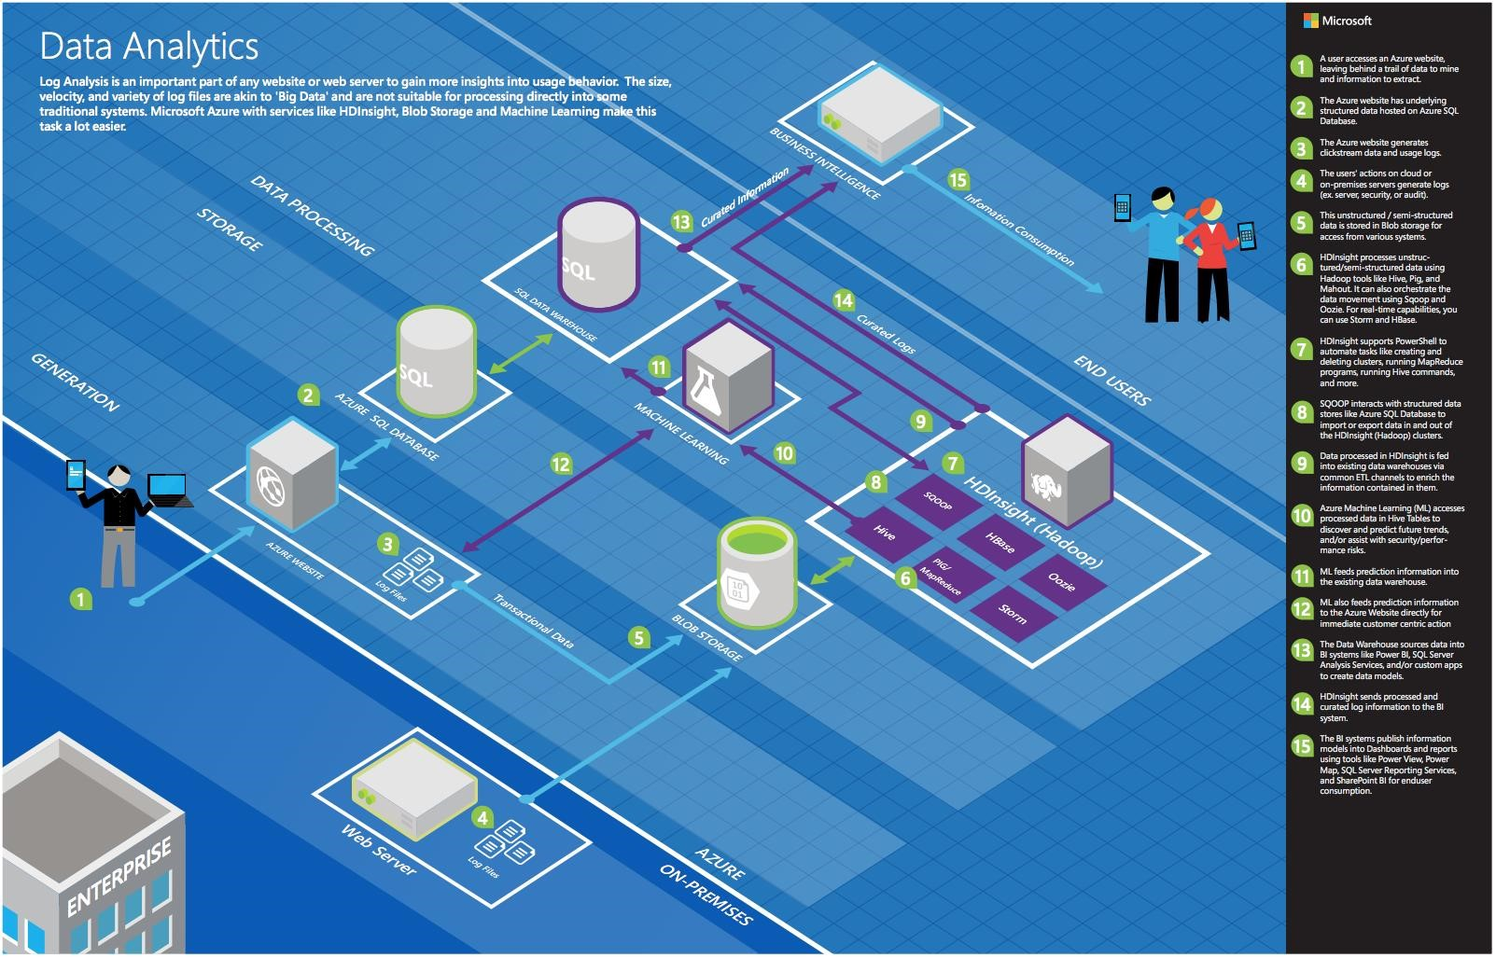
Common scenarios
Notes:
This is a diagram of a common architecture for this type of scenario, which you can draw inspiration from. You will find this diagram within the Whiteboard Design Session Student Guide.

Slide 13
Step 2: Design the solution
Outcome
Design a solution and prepare to present the solution to the target customer audience in a 15-minute chalk-talk format.
Timeframe
60 minutes
Business needs (10 minutes) | Respond to questions outlined in your guide and list the answers on a flipchart.
Design (35 minutes) | Design a solution for as many of the stated requirements as time allows. Show the solution on a flipchart.
Prepare (15 minutes) | Identify any customer needs that are not addressed with the proposed solution. Identify the benefits of your solution. Determine how you will respond to the customer’s objections. Prepare for a 15-minute presentation to the customer.

Slide 14
Step 3: Present the solution
Outcome
Present a solution to the target customer in a 15-minute chalk-talk format
Timeframe
30 minutes (15 minutes for each team to present and receive feedback)
Directions
Pair with another table
One table is the Microsoft team and the other table is the customer
The Microsoft team presents their proposed solution to the customer
The customer asks one of the objections from the list of objections in the case study
The Microsoft team responds to the objection
The customer team gives feedback to the Microsoft team

Slide 15
Wrap-up
Outcome
Identify the preferred solution for the case study
Identify solutions designed by other teams
Timeframe
15 minutes

Slide 16

Preferred target audience
Jack Tradewinds, CIO of AdventureWorks Travel
The primary audience is business decision makers and technology decision makers.
Usually we talk to the Infrastructure Managers who report to the CIOs, or to application sponsors (like a VP LOB, CMO) or to those who represent the Business Unit IT or developers that report to application sponsors.
Notes:
Jack Tradewinds, CIO of AdventureWorks Travel
The primary audience is business decision makers and technology decision makers.
Usually we talk to the Infrastructure Managers who report to the CIOs, or to application sponsors (like a VP LOB, CMO) or to those that represent the Business Unit IT or developers that report to application sponsors.

Slide 17
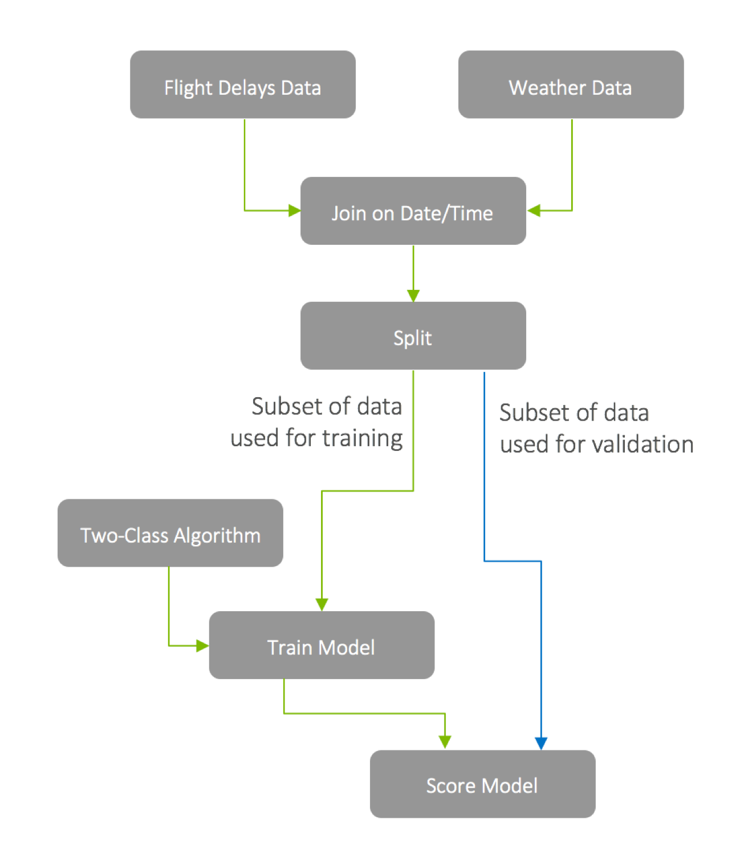
Preferred solution
Machine learning model
Start with domain knowledge
Remove fields that do not add value
Validate preliminary model against training data
Notes:
What attributes of the flight and weather data do you think AWT should use in predicting flight delays? How would you recommend that AWT identify the columns that provide the most predictive value in determining if a flight will be delayed? Be specific on the particular modules or libraries they could use and how they would apply them against the data.
There are multiple approaches AWT could use to perform feature selection and to identify the data attributes that are the most helpful in accurately predicting a delay.
Start with any domain knowledge they have—this would likely point in the direction of the flight attribute’s airline, departure airport, destination airport, and time of day as well as the weather attribute’s wind speed, temperature, and precipitation conditions.
Additionally, they should use the Evaluate Statistics module to identify and remove fields that do not add value (for example, because they are mostly empty or only have a constant value).
Construct a preliminary model and validate how it performs against the training data.
In additional passes, they might choose to use the Feature Selection modules or the Principal Component Analysis module that statistically rank the fields that provide the greatest predictive value against the training data.

Slide 18


Preferred solution
Machine learning model
Data lunging with R or Python
Reserve some historical data to “test” the model
Measure error on the training set and validation sets separately for indicator of whether model is in danger overfitting
Notes:
Some of the data may need a little touching up: columns need to be removed, data types need to be changed. How would these steps be applied in your model?
Data munging can be best accomplished using R or Python, languages familiar to data scientists and developers. These languages provide powerful data transformation capabilities, and allow for flexibility in how data cleanup occurs, while reducing the overall complexity of ML models. These can be expressed using Execute R and Execute Python Script modules.
How would you recommend AWT measure the success of their model?
To properly measure the success of a classification model, it is important to reserve some of the historical data to “test” the model, and never use it for training, to see how it performs against a known outcome.
Measuring the error on the training set and validation set separately gives a clear indicator of whether the model is in danger overfitting.
The output of the prediction as well as the “correct” output is passed to the Evaluate Model module which provides scores such as those from the Confusion Matrix that give a perspective on accuracy and in what situations the models makes mistakes.
A more sophisticated validation model could involve using an ensemble approach, such as that provided by the Cross Validate Model module which takes multiple passes through the input data set to ascertain the performance.

Slide 19
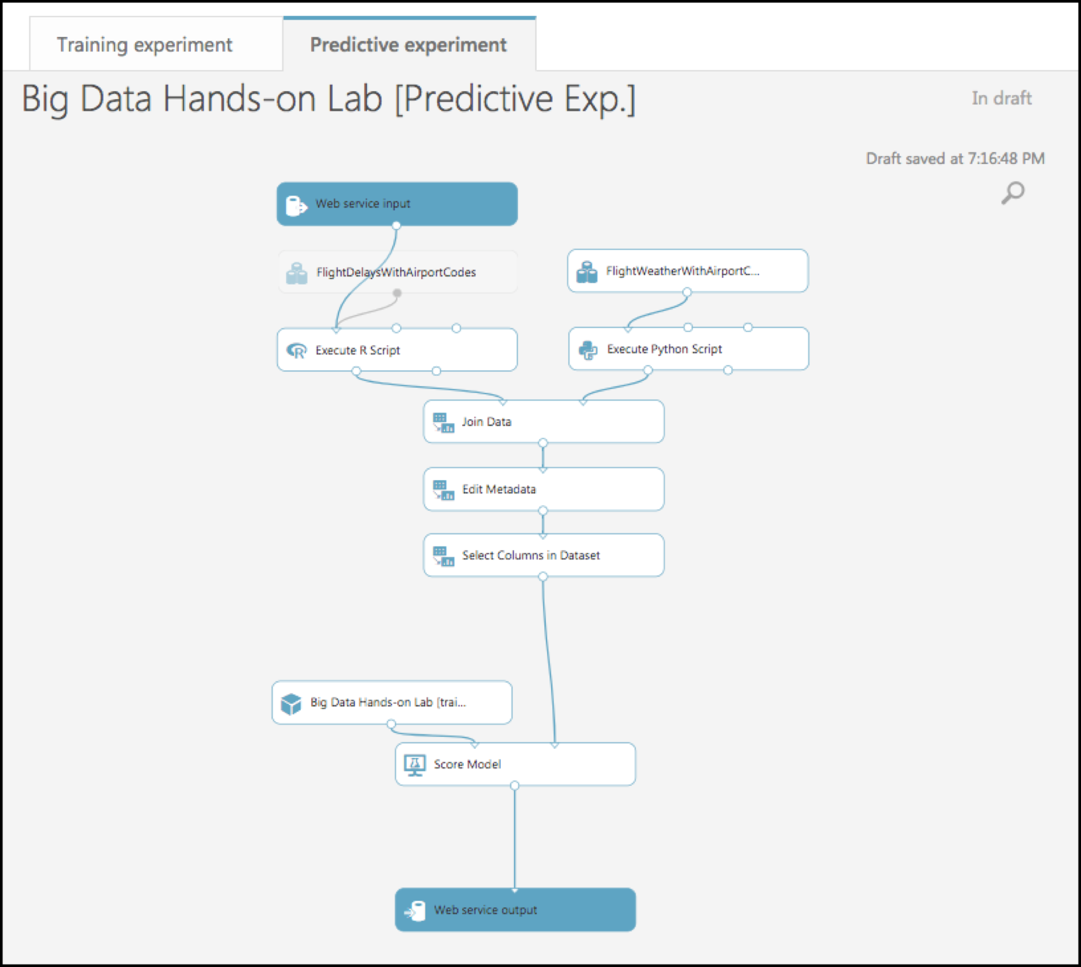


Preferred solution
Operationalizing machine learning
Publish via Azure ML Studio
Operationalize
Predictive web service
(REST API)
Azure ML Studio
Notes:
How can AWT release their model for production use and avoid their concerns about extremely long delays operationalizing the model? Be specific on how your model is packaged, hosted, and invoked.
AWT can release their model for production use by publishing in as a Predictive Web Service in the Azure ML Studio.
Use ML Studio to create a Predictive Web Service around it.
This will package the scoring function of the model so that it can be invoked via a REST call that takes the weather conditions and flight information as input and returns a response with the classification.
The service is hosted by Azure ML.

Slide 20




Preferred solution
Operationalizing machine learning
Azure ML scoring
web service
Flight delays
web portal
Azure blob storage
Query for delay prediction
Query 3rd party REST API
for weather forecast
Azure Data Factory
MLp predictive pipeline
Notes:
AWT has shown interest in not only scoring a flight at a time (based on a customer’s request), but also doing scoring in large chunks so that they could show summaries of predicted flight delays across the United States. What changes would you need to make to your ML model to support this?
Use Azure ML’s Batch Execution API called via a Machine Learning Predictive pipeline created in Azure Data Factory. ADF will handle calling the Batch Execute API of the published predictive web service to score the historical data.
The ADF pipeline will write the scored result files back to blob storage.
It would not require any changes to their ML model. ADF will handle calling the batch execution API, and the location of the scored files is set in the ADF pipeline.
How would you suggest AWT integrate weather forecast data?
They could retrieve the weather forecast data from a third-party service that provides a REST API. An example of such a service is weatherunderground.com.

Slide 21


Preferred solution
Data reparation
Explore & prepare data
Spark SQL
Spark cluster
on HDInsight
Jupyter notebook used
by AWT analysts
Notes:
What service would you recommend AWT capitalize on in order to explore the flat files they get from the United States Department of Transportation (USDOT) using SQL?
AWT could use either HDInsight or SQL Data Warehouse (SQL DW) to prepare their data using SQL. Spark on HDInsight provides Spark SQL, and SQL DW would enable them to use PolyBase to query files that live on Hadoop Distributed File System (HDFS).
If you suggested HDInsight, what specific configuration would you use? What components of the Hadoop stack would you use to allow AWT analysts to query and prep the data? How would they author and execute these data prep tasks?
If recommending HDInsight, the configuration should be to use Spark on HDInsight. By using a Jupyter notebook on their HDInsight Spark cluster, AWT will get a preset sqlContext that can be used to run Hive queries using Spark SQL on the data in HDFS. Using Spark SQL, the historical flight and weather data can be saved into Hive tables.
If you suggested SQL Data Warehouse, explain how you would configure the SQL DW instance?
If recommending SQL Data Warehouse (SQL DW), they could query the files in HDFS using PolyBase. AWT would need to create the appropriate external tables atop the flight delay files available in HDFS, which actually live in the Azure Storage account that is registered with their SQL Data Warehouse instance.
Why did you recommend HDInsight over SQL Data Warehouse or vice versa?
While AWT could use either HDInsight or SQL Data Warehouse (SQL DW), the preferred solution for data preparation is to use a Spark cluster on HDInsight because the customer expressed interest in it. Within a Jupyter notebook on their HDInsight Spark cluster, developers can use either Scala or Python to easily work with files stored in Azure storage, where they will get a preset sqlContext that can be used to run Hive queries using Spark SQL. Spark SQL allows developers to leverage their existing SQL skills to query the historical flight and weather data, and write those data into Hive tables accessible to Power BI, allowing easy visualization and access to reporting on data scored by their Machine Learning models.

Slide 22
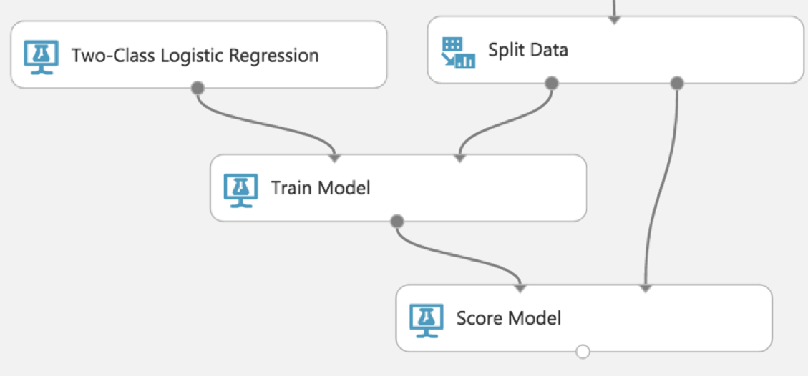
Preferred solution
Machine learning model
Prep data with Spark SQL
Spark cluster
on HDInsight
Azure Machine Learning (ML) with Two-class logistic regression
Notes:
What technology would you recommend that AWT use for implementing their machine learning model?
Azure Machine Learning (Azure ML)
How would you guide AWT to load data so it can be processed by the machine learning model?
The data used for training would need to be uploaded into a dataset or accessed using the Reader module from Azure Storage blobs. Some amount of data preparation work would need to be done first using Spark to create subsets of data that will be used for training and validation.
What category of machine learning algorithm would you recommend to AWT for use in constructing their model? For this scenario your options are clustering, regression or two-class classification. Why?
Given that AWT only wants a binary prediction of flight delayed or flight not delayed, they should proceed with a two-class classification algorithm.

Slide 23


Preferred solution
Data Loading
Integration runtime
Monthly copy activity
Historical flight
& weather data
Azure data factory
Azure blob storage
Notes:
How would you recommend that AWT get their historical data into Azure? What services would you suggest, and what are the specific steps they would need to take to prepare and transfer the data? Where would the loaded data land?
Loading historical flight and weather data from their on-premises data store into Azure should be preformed using Azure Data Factory (ADF).
Use a continuous pipeline containing a copy activity configured to copy time partitioned source data into Azure
Scheduled job will copy all historical files into Azure storage, as well as ingest any future data
Because their historical data is stored on-premises, AWT would need to install and configure an Azure Data Factory Integration Runtime (formerly known as a Data Management Gateway). Once in place, this would allow ADF to copy data from their local data store to a container in blob storage.
Their pipeline would be configured to run monthly, as that is the frequency at which new data is received, and this would still allow for all their historical data to be copied without delay.

Slide 24
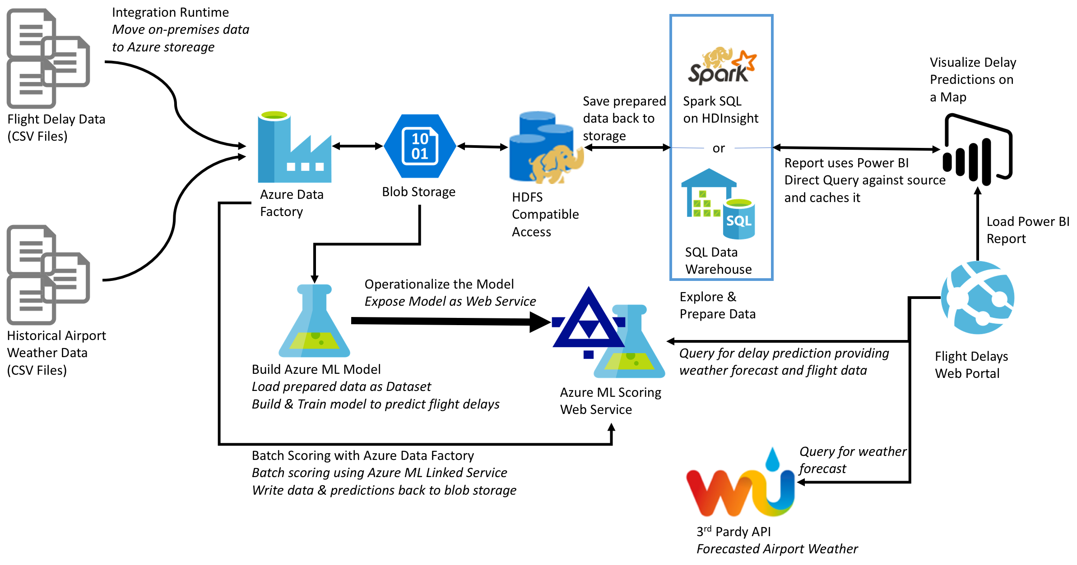
Preferred solution
Notes:
At a high level:
Historical data being copied into Azure blob storage utilizing Azure Data Factory
Historical data explored and prepared using Spark SQL on HDInsight or SQL Data Warehouse
Azure Machine Learning model created and operationalized into a published Predictive Web Service for the web app to query
Batch ML scoring handled via Azure Data Factory. Data written back to blob storage, for querying via Spark SQL.
Map visualizations are provided via an embedded Power BI report
Weather forecast data is provided through a third-party API, such as weatherunderground.com.

Slide 25
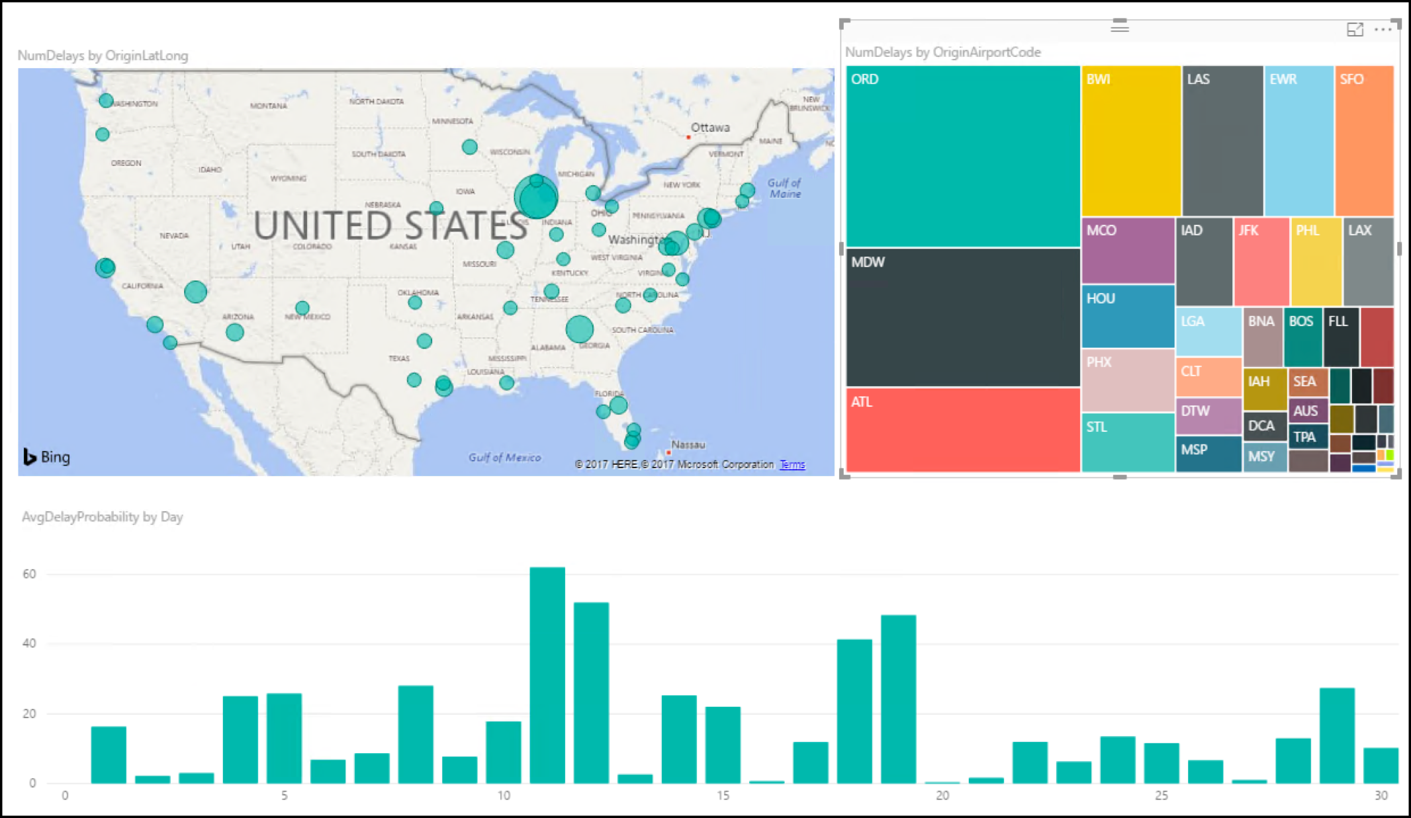
Preferred solution
Visualization and reporting
Power BI is a good option
Direct Query against Spark Hive tables
Use map visualization
Notes:
Is Power BI an option for AWT to use in visualizing the flight delays?
Yes, Power BI is a good option for AWT’s reporting needs, and provides a visual for displaying flight delay predictions on a map.
How would AWT load the data and plot it on a map? What specific components would you use and how would you configure them to display the data?
The preferred solution for visualizing bulk delay predictions is to load a Power BI embedded report containing map visualizations for delays by airport into the Flight Delays web app. The report uses Power BI Direct Query against a Hive table generated in HDInsight.

Slide 26

Preferred solution
Visualization and reporting
Use Query Editor component of the Power BI Desktop, then upload to Power BI service
Create content pack with Power BI
Restrict access in Azure AD
Notes:
If they need to make minor changes, such as a change to the data types of a column in the model, how would they perform this in Power BI?
Minor changes, such as a change to the data types of a column in the model, can be accomplished using the Query Editor component of the Power BI Desktop application. They could then upload this file to the Power BI service.
How could they secure access to these reports to only their internal customer service agents?
Access to these reports can be secured to only their internal customer service agents by utilizing the Power BI service. They can create a Content Pack that contains only the desired dashboards, reports, and datasets and restrict access to those groups in Azure Active Directory to which the customer service agents belong.

Slide 27
Customer objections
Does Azure Machine Learning require a PhD in statistics?
How long does it take to create and operationalize a machine learning model?
Can operationalized ML models be flexible in the inputs they support?
Notes:
Does Azure offer a machine learning solution that does not require a PhD in statistics?
Yes. Azure Machine Learning provides tools that are powerful enough for the data scientist, but are approachable by the developer.
We have heard that creating a machine learning model takes a month to build and another 2–3 months to operationalize so that it is useable from our production systems. Is this true?
This is true in the traditional process for creating machine learning models, whereby the data scientist creates a model (for example, in R) and then hands it over to developers who translate it into Java or C#—which can take months to get the translation correct and performant. With Azure ML, operationalizing a model is done by converting a scoring experiment into a Web service, which takes only a few clicks.
We’d like our operationalized models to be flexible in the inputs they support. In some cases, we want to provide both the flight and weather data to get a prediction. In others we just want to provide flight data and have the weather looked up. Is this possible?
Yes. It is possible to add multiple web service input modules to the experiment, allowing you to add multiple sources, joining them at runtime or processing them separately.

Slide 28
Customer objections
What are the options for running SQL on Hadoop solutions in Azure?
Does Azure offer anything to speed up querying files in HDFS?
How can we identify, monitor, and protect PII data?
Notes:
Can we query flat files in the file system using SQL?
Yes. There are many options for using a SQL syntax to query files in Blob storage such as SQL Data Warehouse and HDInsight with Spark SQL or Hive.
Is HDInsight our only option for running SQL on Hadoop solutions in Azure?
No. Hortonworks , Cloudera and MapR provide fully supported distributions that are available in the Azure Marketplace and provide environments for running HiveQL and Spark SQL in Azure.
Does Azure provide anything that would speed up querying (and exploration) of files in HDFS?
Yes. SQL Data Warehouse provides the ability to create indices on flat file content, as does Hive on HDInsight.
Spark SQL on HDInsight provides a distributed in-memory cache that can aid exploratory queries that often repeat queries against the same subsets of data.
Are there any additional services in the Azure Marketplace we could use to apply data-centric security—that is to identify data loaded that contains PII, monitor access to sensitive data and protect the data at rest (via encryption or masking)?
DataGuise provides the DGSecure product line that provides support for the automated detection of sensitive information at the time of data ingest by means of its DGSecure Ingest Agents (which include agents for relational databases, FTP and Apache Flume).
Sensitive information can also be identified after it is stored in HDFS or Blob by using a Hadoop or HDInsight cluster to run periodic map/reduce scans for sensitive data on disk. The actions taken after discovery of sensitive data can range from flagging the data sensitive (for monitoring and notification purposes), to modifying the data where the sensitive data is masked or encrypted and then updated in the data store.
DGMonitor provides the ability to centralize monitoring of access to sensitive data, as well as raising alerts when suspicious activity is detected.

Slide 29
Customer objections
Is Azure Data Lake a good fit for our PoC?
Can access to our SQL DW be limited using Azure Active Directory?
What data visualization tools are available on Azure? Can access to these be managed with Active Directory?
Notes:
We’ve heard of Azure Data Lake, but we’re not clear if this currently a good fit for our PoC solution, or if we should be using it for interactive analysis of our data.
Azure Data Lake Analytics provides a distributed querying engine whose costs are based solely on the number of resources used in the query, the amount of time those resources were made available to the query and a nominal job completion charge.
Azure Data Lake Analytics currently supports only Batch workloads, so it is not the right tool for interactive analytic workloads.
Azure Data Lake Store provides the ability to store an unlimited number of items, each of unlimited size, having no upper limit on the total storage capacity.
In the long run, Azure Data Lake Store is where the customer should consider landing all of their data, but for the purposes of the PoC using Azure Blob Storage is the easier to implement because of its built-in support from the portal.
We would like to limit access to our SQL DW using centralized Azure Active Directory accounts and groups. Is this possible? I thought I was limited to a user name and password.
It is possible to authenticate to SQL Data Warehouse with an AAD account. Furthermore, you can restrict access to members of certain AAD groups. However, there are certain limitations, such as PolyBase being unable to use AAD for authentication. Also, there is currently no way to use AAD authentication to SQL DW from Power BI.
Does Azure provide any tools for visualizing our data? Ideally access to these could be managed with Active Directory.
Power BI is available as a service and provides tools for creating both dashboards and reports whose access can be restricted by group membership in Azure Active Directory.

Slide 30
Customer quote
“We are flying into the future with Azure, helping our customers more aggressively schedule their travel, and optimize their non-travel time.”
- Jack Tradewinds, CIO of AdventureWorks Travel

